Slide 1


Slide 2
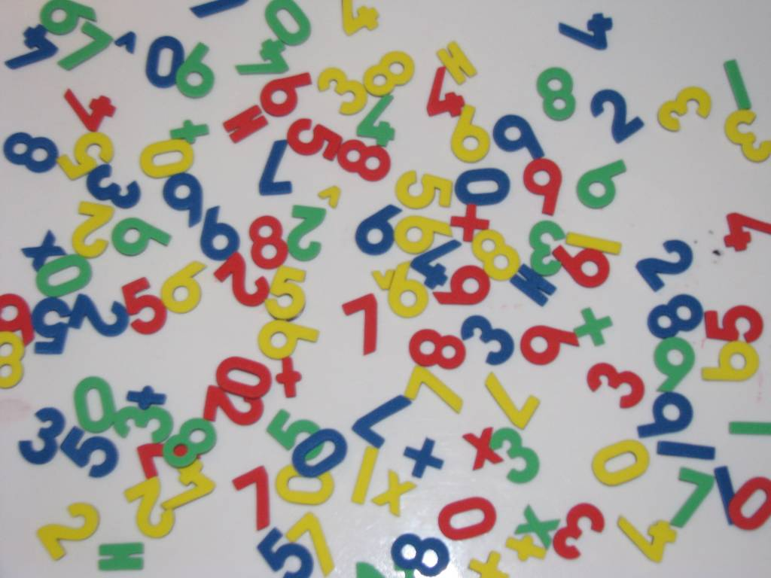
COMPARARTIVE STUDY AND IMPLEMENTATION OF CONVENTIONAL ALGORITHMS & INNOVATION OF SORTING ALGORITHMS
Prepared By…
SUJOYA DAS
MANISH KUMAR GUPTA
MD. RAMEEZ RAJA
ARUP SINGHA
MD. IMRAN ANSARI
SWARNA BASU
SARITA CHAURASIA
Under Guidance Of MR. TAUFIQUE AHMMAD GAZI ( LECTURER CST)

Slide 3
What is a Project?
Its nothing but one’s creativity and innovation to achieve an aim.
It gives students the opportunity to gain professional skills.
It provides a talent for teamwork, and the confidence to dive right in.

Slide 4
Why we chose this Project?
Since the dawn of computing, the sorting problem has attracted a great deal of research. Perhaps due to the complexity of solving it efficiently despite its simple.
It attracts our attention too.
Though there are various conventional algorithms already available, we thought to have a research on these algorithms and if possible to develop a new algorithm which is better & effective as per as complexity concern over the conventional algorithms already available.

Slide 5
PRESENTATION OUTLINE
Project Details
Introduction
Various Conventional Algorithms
Need of Asymptotic Notation
Our Innovation- Digit Sort
Snapshots
Conclusion
Bibliography
Thank You

Slide 6
PROJECT DETAILS
Front End : C Language
Back End : No Such Database. Random input from the user.
Project Type: Analytical Project.
Project Area: Sorting Algorithm Analysis.
Project Goal: If Possible, proposed an algorithm which is best sorting algorithm according to complexity.

Slide 7
INTRODUCTION
Keeping Data & Information in an organized manner in memory.
Organisation of data is done by various sorting algorithms.
The algorithms with better speed is considered as better Sorting algorithms.
In this Project, goal is to study different conventional algorithms.
Also, to develop an algorithm which is better & effective as per complexity concern.

Slide 8
VARIOUS CONVENTIONAL ALGORITHMS
Bubble Sort
Radix Sort
Selection Sort
Quick Sort
Comb Sort
Bucket Sort
Cocktail Sort
Merge Sort
Counting Sort
Heap Sort
Merge Sort
Shell Sort

Slide 9
BUBBLE SORT

Slide 10
How it Works?
Sorting takes an unordered collection and makes it an ordered one.
1 2 3 4 5 6
77
42
35
12
101
5
1 2 3 4 5 6
5
12
35
42
77
101

Slide 11
"Bubbling Up" the Largest Element
Traverse a collection of elements
Move from the front to the end
“Bubble” the largest value to the end using pair-wise comparisons and swapping.
1 2 3 4 5 6
77
42
35
12
101
5

Slide 12
"Bubbling Up" the Largest Element
Traverse a collection of elements
Move from the front to the end
“Bubble” the largest value to the end using pair-wise comparisons and swapping.
Swap
1 2 3 4 5 6
42
77
77
42
35
12
101
5

Slide 13
"Bubbling Up" the Largest Element
Traverse a collection of elements
Move from the front to the end
“Bubble” the largest value to the end using pair-wise comparisons and swapping.
1 2 3 4 5 6
Swap
35
77
42
77
35
12
101
5

Slide 14
"Bubbling Up" the Largest Element
Traverse a collection of elements
Move from the front to the end
“Bubble” the largest value to the end using pair-wise comparisons and swapping.
1 2 3 4 5 6
Swap
12
77
42
35
77
12
101
5

Slide 15
"Bubbling Up" the Largest Element
Traverse a collection of elements
Move from the front to the end
“Bubble” the largest value to the end using pair-wise comparisons and swapping.
1 2 3 4 5 6
42
35
12
77
101
5
No need to swap

Slide 16
"Bubbling Up" the Largest Element
Traverse a collection of elements
Move from the front to the end
“Bubble” the largest value to the end using pair-wise comparisons and swapping.
1 2 3 4 5 6
Swap
5
101
42
35
12
77
101
5

Slide 17
"Bubbling Up" the Largest Element
Traverse a collection of elements
Move from the front to the end
“Bubble” the largest value to the end using pair-wise comparisons and swapping.
1 2 3 4 5 6
101
42
35
12
77
5
Largest value correctly placed

Slide 18
Repeat Bubble-Up how many times?
If we have N elements…
And if each time we bubble an element, we place it in its correct location…
Then we repeat the “bubble up” process N – 1 times.
This guarantees we’ll correctly place all N elements.

Slide 19
RADIX SORT

Slide 20
Radix Sort properties
Radix sort is generalization of bucket sort.
It uses several passes of bucket sort
Perform the bucket sorts by “least significant digits”
First sort by digit in units place
Second sort by digit in tens place
Third sort by digit in hundreds place and so on..

Slide 21
Let’s sort the following array using radix sort:
64
8
216
512
27
729
0
1
343
125

Slide 22
Pass 1

Slide 23
0
1
2
3
4
5
6
7
8
9

Slide 24
64
8
216
512
27
729
0
1
343
125
0
1
2
3
4
5
6
7
8
9

Slide 25
64
8
216
512
27
729
0
1
343
125
0
1
2
3
4
5
6
7
8
9

Slide 26
64
8
216
512
27
729
0
1
343
125
0
1
2
3
4
64
5
6
7
8
9

Slide 27
64
8
216
512
27
729
0
1
343
125
0
1
2
3
4
64
5
6
7
8
9

Slide 28
64
8
216
512
27
729
0
1
343
125
0
1
2
3
4
64
5
6
7
8
8
9

Slide 29
64
8
216
512
27
729
0
1
343
125
0
1
2
3
4
64
5
6
7
8
8
9

Slide 30
64
8
216
512
27
729
0
1
343
125
0
1
2
3
4
64
5
6
216
7
8
8
9

Slide 31
64
8
216
512
27
729
0
1
343
125
0
1
2
3
4
64
5
6
216
7
8
8
9

Slide 32
64
8
216
512
27
729
0
1
343
125
0
1
2
512
3
4
64
5
6
216
7
8
8
9

Slide 33
64
8
216
512
27
729
0
1
343
125
0
1
2
512
3
4
64
5
6
216
7
8
8
9

Slide 34
64
8
216
512
27
729
0
1
343
125
0
1
2
512
3
4
64
5
6
216
7
27
8
8
9

Slide 35
64
8
216
512
27
729
0
1
343
125
0
1
2
512
3
4
64
5
6
216
7
27
8
8
9

Slide 36
64
8
216
512
27
729
0
1
343
125
0
1
2
512
3
4
64
5
6
216
7
27
8
8
9
729

Slide 37
64
8
216
512
27
729
0
1
343
125
0
1
2
512
3
4
64
5
6
216
7
27
8
8
9
729

Slide 38
64
8
216
512
27
729
0
1
343
125
0
0
1
2
512
3
4
64
5
6
216
7
27
8
8
9
729

Slide 39
64
8
216
512
27
729
0
1
343
125
0
0
1
2
512
3
4
64
5
6
216
7
27
8
8
9
729

Slide 40
64
8
216
512
27
729
0
1
343
125
0
0
1
1
2
512
3
4
64
5
6
216
7
27
8
8
9
729

Slide 41
64
8
216
512
27
729
0
1
343
125
0
0
1
1
2
512
3
4
64
5
6
216
7
27
8
8
9
729

Slide 42
64
8
216
512
27
729
0
1
343
125
0
0
1
1
2
512
3
343
4
64
5
6
216
7
27
8
8
9
729

Slide 43
64
8
216
512
27
729
0
1
343
125
0
0
1
1
2
512
3
343
4
64
5
6
216
7
27
8
8
9
729

Slide 44
64
8
216
512
27
729
0
1
343
125
0
0
1
1
2
512
3
343
4
64
5
125
6
216
7
27
8
8
9
729

Slide 45
64
8
216
512
27
729
0
1
343
125
0
0
1
1
2
512
3
343
4
64
5
125
6
216
7
27
8
8
9
729

Slide 46
0
0
1
1
2
512
3
343
4
64
5
125
6
216
7
27
8
8
9
729

Slide 47
0
0
1
1
2
512
3
343
4
64
5
125
6
216
7
27
8
8
9
729

Slide 48
0
0
0
1
1
2
512
3
343
4
64
5
125
6
216
7
27
8
8
9
729

Slide 49
0
0
1
1
2
512
3
343
4
64
5
125
6
216
7
27
8
8
9
729

Slide 50
0
0
1
1
2
512
3
343
4
64
5
125
6
216
7
27
8
8
9
729

Slide 51
0
1
0
1
1
2
512
3
343
4
64
5
125
6
216
7
27
8
8
9
729

Slide 52
0
1
0
1
2
512
3
343
4
64
5
125
6
216
7
27
8
8
9
729

Slide 53
0
1
512
0
1
2
512
3
343
4
64
5
125
6
216
7
27
8
8
9
729

Slide 54
0
1
512
0
1
2
3
343
4
64
5
125
6
216
7
27
8
8
9
729

Slide 55
Pass 2

Slide 56
0
1
512
343
64
125
216
27
8
729
0
1
2
3
4
5
6
7
8
9

Slide 57
00
1
512
343
64
125
216
27
8
729
0
1
2
3
4
5
6
7
8
9

Slide 58
0
1
512
343
64
125
216
27
8
729
0
0
1
2
3
4
5
6
7
8
9

Slide 59
0
01
512
343
64
125
216
27
8
729
0
0
1
2
3
4
5
6
7
8
9

Slide 60
0
1
512
343
64
125
216
27
8
729
0
0
1
1
2
3
4
5
6
7
8
9

Slide 61
0
1
512
343
64
125
216
27
8
729
0
0
1
1
2
3
4
5
6
7
8
9

Slide 62
0
1
512
343
64
125
216
27
8
729
0
0
1
1
512
2
3
4
5
6
7
8
9

Slide 63
0
1
512
343
64
125
216
27
8
729
0
0
1
1
512
2
3
4
5
6
7
8
9

Slide 64
0
1
512
343
64
125
216
27
8
729
0
0
1
1
512
2
3
4
343
5
6
7
8
9

Slide 65
0
1
512
343
64
125
216
27
8
729
0
0
1
1
512
2
3
4
343
5
6
7
8
9

Slide 66
0
1
512
343
64
125
216
27
8
729
0
0
1
1
512
2
3
4
343
5
6
64
7
8
9

Slide 67
0
1
512
343
64
125
216
27
8
729
0
0
1
1
512
2
3
4
343
5
6
64
7
8
9

Slide 68
0
1
512
343
64
125
216
27
8
729
0
0
1
1
512
2
125
3
4
343
5
6
64
7
8
9

Slide 69
0
1
512
343
64
125
216
27
8
729
0
0
1
1
512
2
125
3
4
343
5
6
64
7
8
9

Slide 70
0
1
512
343
64
125
216
27
8
729
0
0
1
1
512
216
2
125
3
4
343
5
6
64
7
8
9

Slide 71
0
1
512
343
64
125
216
27
8
729
0
0
1
1
512
216
2
125
3
4
343
5
6
64
7
8
9

Slide 72
0
1
512
343
64
125
216
27
8
729
0
0
1
1
512
216
2
125
27
3
4
343
5
6
64
7
8
9

Slide 73
0
1
512
343
64
125
216
27
08
729
0
0
1
1
512
216
2
125
27
3
4
343
5
6
64
7
8
9

Slide 74
0
1
512
343
64
125
216
27
8
729
0
0
1
8
1
512
216
2
125
27
3
4
343
5
6
64
7
8
9

Slide 75
0
1
512
343
64
125
216
27
8
729
0
0
1
8
1
512
216
2
125
27
3
4
343
5
6
64
7
8
9

Slide 76
0
1
512
343
64
125
216
27
8
729
0
0
1
8
1
512
216
2
125
27
729
3
4
343
5
6
64
7
8
9

Slide 77
0
1
512
343
64
125
216
27
8
729
0
0
1
8
1
512
216
2
125
27
729
3
4
343
5
6
64
7
8
9

Slide 78
0
0
1
8
1
512
216
2
125
27
729
3
4
343
5
6
64
7
8
9

Slide 79
0
1
8
0
0
1
8
1
512
216
2
125
27
729
3
4
343
5
6
64
7
8
9

Slide 80
0
1
8
0
1
512
216
2
125
27
729
3
4
343
5
6
64
7
8
9

Slide 81
0
1
8
512
216
0
1
512
216
2
125
27
729
3
4
343
5
6
64
7
8
9

Slide 82
0
1
8
512
216
0
1
2
125
27
729
3
4
343
5
6
64
7
8
9

Slide 83
0
1
8
512
216
125
27
729
0
1
2
125
27
729
3
4
343
5
6
64
7
8
9

Slide 84
0
1
8
512
216
125
27
729
0
1
2
3
4
343
5
6
64
7
8
9

Slide 85
0
1
8
512
216
125
27
729
343
0
1
2
3
4
343
5
6
64
7
8
9

Slide 86
0
1
8
512
216
125
27
729
343
0
1
2
3
4
5
6
64
7
8
9

Slide 87
0
1
8
512
216
125
27
729
343
64
0
1
2
3
4
5
6
64
7
8
9

Slide 88
Pass 3

Slide 89
0
1
8
512
216
125
27
729
343
64
0
1
2
3
4
5
6
7
8
9

Slide 90
000
1
8
512
216
125
27
729
343
64
0
1
2
3
4
5
6
7
8
9

Slide 91
0
1
8
512
216
125
27
729
343
64
0
0
1
2
3
4
5
6
7
8
9

Slide 92
0
001
8
512
216
125
27
729
343
64
0
0
1
2
3
4
5
6
7
8
9

Slide 93
0
1
8
512
216
125
27
729
343
64
0
0
1
1
2
3
4
5
6
7
8
9

Slide 94
0
1
008
512
216
125
27
729
343
64
0
0
1
1
2
3
4
5
6
7
8
9

Slide 95
0
1
8
512
216
125
27
729
343
64
0
0
1
8
1
2
3
4
5
6
7
8
9

Slide 96
0
1
8
512
216
125
27
729
343
64
0
0
1
8
1
2
3
4
5
6
7
8
9

Slide 97
0
1
8
512
216
125
27
729
343
64
0
0
1
8
1
2
3
4
5
512
6
7
8
9

Slide 98
0
1
8
512
216
125
27
729
343
64
0
0
1
8
1
2
3
4
5
512
6
7
8
9

Slide 99
0
1
8
512
216
125
27
729
343
64
0
0
1
8
1
2
216
3
4
5
512
6
7
8
9

Slide 100
0
1
8
512
216
125
27
729
343
64
0
0
1
8
1
2
216
3
4
5
512
6
7
8
9

Slide 101
0
1
8
512
216
125
27
729
343
64
0
0
1
8
1
125
2
216
3
4
5
512
6
7
8
9

Slide 102
0
1
8
512
216
125
027
729
343
64
0
0
1
8
1
125
2
216
3
4
5
512
6
7
8
9

Slide 103
0
1
8
512
216
125
27
729
343
64
0
0
1
8
27
1
125
2
216
3
4
5
512
6
7
8
9

Slide 104
0
1
8
512
216
125
27
729
343
64
0
0
1
8
27
1
125
2
216
3
4
5
512
6
7
8
9

Slide 105
0
1
8
512
216
125
27
729
343
64
0
0
1
8
27
1
125
2
216
3
4
5
512
6
7
729
8
9

Slide 106
0
1
8
512
216
125
27
729
343
64
0
0
1
8
27
1
125
2
216
3
4
5
512
6
7
729
8
9

Slide 107
0
1
8
512
216
125
27
729
343
64
0
0
1
8
27
1
125
2
216
3
343
4
5
512
6
7
729
8
9

Slide 108
0
1
8
512
216
125
27
729
343
064
0
0
1
8
27
1
125
2
216
3
343
4
5
512
6
7
729
8
9

Slide 109
0
1
8
512
216
125
27
729
343
64
0
0
1
8
27
64
1
125
2
216
3
343
4
5
512
6
7
729
8
9

Slide 110
0
1
8
512
216
125
27
729
343
64
0
0
1
8
27
64
1
125
2
216
3
343
4
5
512
6
7
729
8
9

Slide 111
0
0
1
8
27
64
1
125
2
216
3
343
4
5
512
6
7
729
8
9

Slide 112
0
1
8
27
64
0
0
1
8
27
64
1
125
2
216
3
343
4
5
512
6
7
729
8
9

Slide 113
0
1
8
27
64
0
1
125
2
216
3
343
4
5
512
6
7
729
8
9

Slide 114
0
1
8
27
64
125
0
1
125
2
216
3
343
4
5
512
6
7
729
8
9

Slide 115
0
1
8
27
64
125
0
1
2
216
3
343
4
5
512
6
7
729
8
9

Slide 116
0
1
8
27
64
125
216
0
1
2
216
3
343
4
5
512
6
7
729
8
9

Slide 117
0
1
8
27
64
125
216
0
1
2
3
343
4
5
512
6
7
729
8
9

Slide 118
0
1
8
27
64
125
216
343
0
1
2
3
343
4
5
512
6
7
729
8
9

Slide 119
0
1
8
27
64
125
216
343
0
1
2
3
4
5
512
6
7
729
8
9

Slide 120
0
1
8
27
64
125
216
343
512
0
1
2
3
4
5
512
6
7
729
8
9

Slide 121
0
1
8
27
64
125
216
343
512
0
1
2
3
4
5
6
7
729
8
9

Slide 122
0
1
8
27
64
125
216
343
512
729
0
1
2
3
4
5
6
7
729
8
9

Slide 123
0
1
8
27
64
125
216
343
512
729
0
1
2
3
4
5
6
7
8
9

Slide 124
SELECTION SORT

Slide 125
How it works?
5 | 1 | 3 | 4 | 6 | 2
Comparison
Data Movement
Sorted

Slide 126
5 | 1 | 3 | 4 | 6 | 2
Comparison
Data Movement
Sorted

Slide 127
5 | 1 | 3 | 4 | 6 | 2
Comparison
Data Movement
Sorted

Slide 128
5 | 1 | 3 | 4 | 6 | 2
Comparison
Data Movement
Sorted

Slide 129
5 | 1 | 3 | 4 | 6 | 2
Comparison
Data Movement
Sorted

Slide 130
5 | 1 | 3 | 4 | 6 | 2
Comparison
Data Movement
Sorted

Slide 131
5 | 1 | 3 | 4 | 6 | 2
Comparison
Data Movement
Sorted

Slide 132
5 | 1 | 3 | 4 | 6 | 2
•
Largest
Comparison
Data Movement
Sorted

Slide 133
5 | 1 | 3 | 4 | 2 | 6
Comparison
Data Movement
Sorted

Slide 134
5 | 1 | 3 | 4 | 2 | 6
Comparison
Data Movement
Sorted

Slide 135
5 | 1 | 3 | 4 | 2 | 6
Comparison
Data Movement
Sorted

Slide 136
5 | 1 | 3 | 4 | 2 | 6
Comparison
Data Movement
Sorted

Slide 137
5 | 1 | 3 | 4 | 2 | 6
Comparison
Data Movement
Sorted

Slide 138
5 | 1 | 3 | 4 | 2 | 6
Comparison
Data Movement
Sorted

Slide 139
5 | 1 | 3 | 4 | 2 | 6
Comparison
Data Movement
Sorted

Slide 140
5 | 1 | 3 | 4 | 2 | 6
•
Largest
Comparison
Data Movement
Sorted

Slide 141
2 | 1 | 3 | 4 | 5 | 6
Comparison
Data Movement
Sorted

Slide 142
2 | 1 | 3 | 4 | 5 | 6
Comparison
Data Movement
Sorted

Slide 143
2 | 1 | 3 | 4 | 5 | 6
Comparison
Data Movement
Sorted

Slide 144
2 | 1 | 3 | 4 | 5 | 6
Comparison
Data Movement
Sorted

Slide 145
2 | 1 | 3 | 4 | 5 | 6
Comparison
Data Movement
Sorted

Slide 146
2 | 1 | 3 | 4 | 5 | 6
Comparison
Data Movement
Sorted

Slide 147
2 | 1 | 3 | 4 | 5 | 6
•
Largest
Comparison
Data Movement
Sorted

Slide 148
2 | 1 | 3 | 4 | 5 | 6
Comparison
Data Movement
Sorted

Slide 149
2 | 1 | 3 | 4 | 5 | 6
Comparison
Data Movement
Sorted

Slide 150
2 | 1 | 3 | 4 | 5 | 6
Comparison
Data Movement
Sorted

Slide 151
2 | 1 | 3 | 4 | 5 | 6
Comparison
Data Movement
Sorted

Slide 152
2 | 1 | 3 | 4 | 5 | 6
Comparison
Data Movement
Sorted

Slide 153
2 | 1 | 3 | 4 | 5 | 6
•
Largest
Comparison
Data Movement
Sorted

Slide 154
2 | 1 | 3 | 4 | 5 | 6
Comparison
Data Movement
Sorted

Slide 155
2 | 1 | 3 | 4 | 5 | 6
Comparison
Data Movement
Sorted

Slide 156
2 | 1 | 3 | 4 | 5 | 6
Comparison
Data Movement
Sorted

Slide 157
2 | 1 | 3 | 4 | 5 | 6
Comparison
Data Movement
Sorted

Slide 158
Selection Sort
2 | 1 | 3 | 4 | 5 | 6
•
Largest
Comparison
Data Movement
Sorted

Slide 159
Selection Sort
1 | 2 | 3 | 4 | 5 | 6
Comparison
Data Movement
Sorted

Slide 160
1 | 2 | 3 | 4 | 5 | 6
DONE!
Comparison
Data Movement
Sorted

Slide 161
BRIEFLY DISCUSS THE SOME OF ALGORITHMS
1. BUBBLE SORT
2. BUCKET SORT
3. HEAP SORT
4. MERGE SORT
5. RADIX SORT
6. SHELL SORT
7. COUNTING SORT
8. COMB SORT

Slide 162
BUBBLE SORT
Bubble sort has many of the same properties as insertion sort, but has slightly higher overhead. In the case of nearly sorted data, bubble sort takes O(n) time, but requires at least 2 passes through the
data (whereas insertion sort requires something more like 1 pass).
ALGORITHM
for i = 1:n,
swapped = false
for j = n:i+1,
if a[j] < a[j-1],
swap a[j,j-1]
swapped = true
break if not swapped
end

Slide 163
COMPLEXITY ANALYSIS
Best Case : n
Worst Case : n^2
Average Case : n^2
ADVANTAGE AND DISADVANTAGE
A bubble sort is a sort where adjacent items in the array or list are scanned repeatedly, swapping as necessary, until one full scan performs no swaps. Advantage is simplicity. Disadvantage is that it can take N scans, where N is the size of the array or list, because an out of position item is only moved one position per scan. This can be mitigated somewhat by starting with a swap gap of greater than one (typically N/2), scanning until no swaps occur, then halving the gap and repeating until the gap is one. This, of course, is no longer a bubble sort - it is a merge exchange sort.

Slide 164
BUCKET SORT
Like counting sort, bucket sort is fast because it assumes something about the input. Whereas counting sort assumes that the input consists of integers in a small range, bucket sort assumes that the input is generated by a random process that distributes elements uniformly.
ALGORITHM
void bubbleSort(int ar[]) {
for (int i = (ar.length - 1); i >= 0; i--) {
for (int j = 1; j ≤ i; j++) {
if (ar[j-1] > ar[j]) {
int temp = ar[j-1];
ar[j-1] = ar[j];
ar[j] = temp;
} } } }

Slide 165
COMPLEXITY ANALYSIS
Best case :
Worst case : o(n+r)
Average case : o(n+r)
ADVANTAGE AND DISADVANTAGE
Bucket sort, or bin sort, is a sorting algorithm that works by partitioning an array into a number of buckets. Each bucket is then sorted individually, either using a different sorting algorithm, or by recursively applying the bucket sorting algorithm. It is a distribution sort, and is a cousin of radix sort in the most to least significant digit flavour. Bucket sort is a generalization of pigeonhole sort. Since bucket sort is not a comparison sort, the O(n log n) lower bound is inapplicable. The computational complexity estimates involve the number.

Slide 166
HEAP SORT
It is a well-known, traditional sorting algorithm you will be expected to know
Heap sort is always O(n log n). Quick sort is usually O(n log n) but in the
worst case slows to O(n²). Quick sort is generally faster, but Heap sort is better in
time critical applications. Heap sort is a really cool algorithm!
ALGORITHM
1. Build a heap with the sorting array, using recursive insertion.
2. Iterate to extract n times the maximum or minimum element in heap and heapify the heap.
3. The extracted elements form a sorted subsequence.
COMPLEXITY ANALYSIS
Best Case : o(n logn)
Worst Case : o(n logn)
Average Case : o(n logn)

Slide 167
ADVANTAGE
1. Efficiency: The Heap sort algorithm is very efficient. While other sorting algorithms may grow exponentially slower as the number of items to sort increase, the time required to perform Heap sort increases logarithmically.
2. Memory Usage: The Heap sort algorithm can be implemented as an in-place sorting algorithm. This means that its memory usage is minimal.
3. Simplicity: The Heap sort algorithm is simpler to understand.
4. Consistency: The Heap sort algorithm exhibits consistent performance. This means it performs equally well in the best, average and worst cases.
DISADVANTAGE
Heap sort is an in- place algorithm, but is not a stable sort.

Slide 168
MERGE SORT
Merge sort O(n log n) comparison based sorting algorithm. Most implementations produce a stable sort, which means that the implementation preserves the input order of equal elements in the sorted output. Merge sort is a divide and conquer algorithm that was invented by John von Neumann in 1945.
ALGORITHM
To sort the entire sequence A[1 .. n], make the initial call to the procedure MERGE-SORT (A, 1, n). MERGE-SORT (A, p, r)
1. IF p<r // Check for base case
2. THEN q = FLOOR[(p + r)/2] // Divide step
3. MERGE (A, p, q) // Conquer step.
4. MERGE (A, q + 1, r) // Conquer step.
5. MERGE (A, p, q, r) // Conquer step.

Slide 169
COMPLEXITY ANALYSIS
Best Case : O(nlogn)
Worst Case : O(nlogn)
Average Case : O(nlogn)
ADVANTAGES
1. Merge sort requires only half as much additional space.
2. It is faster than the other variants, and it is stable
DISADVANTAGES
Merge sort needs an additional space of Θ(n) for the temporary array.

Slide 170
RADIX SORT
In computer science, radix sort is a non comparative integer sorting algorithm that sorts data with integer keys by grouping keys by the individual digits which share the same significant position and value. A positional notation is required, but because integers can represent strings of characters and specially formatted floating point numbers, radix sort is not limited to integers.
ALGORITHM
Radix (item [], N) /* item is an array of size N */
{ Initialize array Q; /*Q is an array of Circular Queue of size 10;*/
Find out the maximum element among the elements of the input array;
Count the digit of the maximum element and store the value into pass;
Initialize div by 1;
For (I=1; I<=pass; I++) {
/*inserting the elements into queue*/
For (J=0; J<N; J++) {
Set remainder is equals to item [J] %( div*10);
Update remainder by (remainder/div);
Insert (&Q [remainder], item [J]);
} Update div by (div*10);
/*deleting the elements from the queue and place them into the array*/
For (J=0, index=0; J<10; J++) While (! Isempty (&Q [J])) item [index++] = Delete (&Q [J]); } }

Slide 171
COMPLEXITY ANALYSIS
Best Case :
Worst Case : O (n)
Average Case :
ADVANTAGE
Radix Sort is stable, meaning it preserves existing order of equal keys. It works in linear time, unlike most other sorts. In other words, it does not bog down when you have large numbers of items to sort. The time per item to sort is constant. With other sorts, the time to sort per time increases with the number of items. Mathematicians would put it that most sorts run in O(n log(n))or O(n²) time, where Radix Sort runs in O(n) time.
DISADVANTAGE
1. Radix Sort does not work well when you have very long keys, because the total sorting time is proportional to key length and to the
number of items to sort. If you insisted thatall records have unique keys, necessarily the keys would have to be at least log₂ (n) bits
long, which would tend to defeat the advantage of Radix Sort. Radix Sort shines when you have large numbers of records to sort
with short keys.
2. Unfortunately, in this particular implementation, 16-bit characters count as two key slots, unless you can guarantee you never user the high order parts. In other words Unicode takes twice as long to sort as byte arrays.

Slide 172
Shell Sort
Most of the sorting algorithms seen so far such as insertion sort and selection sort have a run time complexity of O(N2). We also know that no sorting algorithm can have time complexity less than O(N), since we need to scan the list at least once. For example, insertion sort best case complexity is O(N). Can we get a better performance and get run time complexity between O(N2) and O(N)? The answer is Yes and there are many algorithms with a complexity in this range, with varying tradeoffs. In this note, we describe one approach: Shell Sort. Shell Sort has evolved as a trial and error algorithm. Analytical results are not available but empirically it has been found that the Shell Sort improves the efficiency and decreases the run time complexity to O(N1.25). Donald Shell discovered the Shell sort and thence it is known as Shell Sort.
ALGORITHM
This sorting algorithm is conceived by D. L. Shell (that's where it gets its name), and is inspired by the Insertion Sort's ability to work very fast on an array that is almost in order. It is also called diminishing increment sort. Unlike Insertion Sort, Shell Sort does not sort the entire array at once. Instead, it divides the array into noncontiguous segments, which are separately sorted by using Insertion Sort. Once all of the segments are sorted, Shell Sort re-divides the array into less segments and
repeat the algorithm until at last that the number of segment equals one, and the segment is sorted. There are two advantages of Shell Sort over Insertion Sort. When the swap occurs in a noncontiguous segment, the swap moves the item over a
greater distance within the overall array. Insertion Sort only moves the item one position at a time. This means that in Shell Sort, the items being swapped are more likely to be closer to its final position then Insertion Sort.
Since the items are more likely to be closer to its final position, the array itself becomes partially sorted. Thus when the segment number equals one, and Shell Sort is performing basically the Insertion Sort, it will be able to work very fast, since Insertion Sort is fast when
the array is almost in order.

Slide 173
COMPLEXITY ANALYSIS
Best Case : o(n)
Worst Case : o(n(logn)^2)
Average Case : o(n^2/3)
ADVANTAGE
1. Advantage of shell sort is that it’s only efficient for medium size lists. For bigger lists, the algorithm is not the best choice fastest of all o(n^2) sorting algorithms.
2. Five times faster than the bubble sort and a little over twice as fast as the insertion sort, its closest competitor
DISADVANTAGE
1. Disadvantage of shell sort is that it is a complex algorithm and it’s not nearly as efficient as the merge sort, heap sort & quick sort.
2. The shell sort is still significantly slower than the merge sort, heap sort & quick sort, but its relatively simple algorithm makes it a good choice for sorting lists of less than five thousand items unless speed important. It’s also an excellent choice for repetitive sorting of smaller lists.

Slide 174
COUNTING SORT
Counting sort is an algorithm that takes an array A of n elements in the range f1, 2, ..., kg and sorts
the array in O(n + k) time. Counting sort uses no comparisons and uses the fact that the n elements are in a
limited range to beat the O(n log n) limit of comparison sorts.
ALGORITHM
COUNTING SORT(A,B,k) algorithm
1 for i = 1 to k
2 do c[i] = 0
3 for j = 1 to length[A]
4 do C[A[j]] = C[A[j]] + 1
5 >C[i] now contains the number of elements equal to i
6 for i = 2 to k
7 do C[i] = C[i] + C[i-1]
8 >C[i] now contains the number of elements less than or equal to i
9 for j = length[A] downto 1
10 do B[C[A[j]]] = A[j]
11 C[A[j]] = C[A[J]] – 1

Slide 175
COMPLEXITY ANALYSIS
Best Case : -
Worst Case : o(n+r)
Average Case : o(n+r)
ADVANTAGE AND DISADVANTAGE
The biggest advantage of counting sort is its complexity –where is the size of the sorted array and is the size of the helper array (range of distinct values). It has also several disadvantages – if non-primitive (object) elements are sorted, another helper array is needed to store the sorted elements. Second and the major disadvantage is that counting sort can be used only to sort discrete values (for example integers), because otherwise the array of frequencies cannot be constructed.

Slide 176
COMB SORT
Comb sort is a relatively simplistic sorting algorithm originally designed by Wlodzimierz Dobosiewicz in 1980. Later it was rediscovered and popularized by Stephen Lacey and Richard Box with a Byte Magazine article published in April 1991. Comb sort improves on bubble sort, and rivals algorithms like Quicksort (visual comparison). The basic idea is to eliminate turtles, or small values near the end of the list, since in a bubble sort these slow the sorting down tremendously. (Rabbits, large values around the beginning of the list, do not pose a problem in bubble sort.).
ALGORITHM
comb_sort (list of t)
gap = list.count
temp as t
swapped = false
while gap > 1 or not swapped
swapped = false
if gap > 1 then
gap = floor(gap/1.3)
i = 0
while i + gap < list.count
if list(i) > list(i + gap)
temp = list(i) // swap
list(i) = list(i + gap)
list(i + gap) = temp
i += 1

Slide 177
COMPLEXITY ANALYSIS
Best Case : o(n)
Worst Case : o(n^2)
Average Case : o(nlogn)
ADVANTAGE AND DISADVANTAGE
Comb sort can be made more effective if the sorting method is changed once the gaps reach numbers small enough. For example, once the gap reaches a size of about 10 or smaller, stopping the comb sort and doing a simple gnome sort or Cocktail Sort, or, even better, an Insertion Sort will increase the sort's overall efficiency. Another advantage of this method is that there is no need to keep track of swaps during the sort passes to know if the sort should stop or not.

Slide 178
Our Proposed Algorithm

Slide 179
Digit Sort
In the above figure the idea behind digit sort is illustrated i.e. if the input elements are of
different digit elements then according to their digit it will be inserted. At the time of
inserting an element into the corresponding digit bucket it will see that the bucket is empty
or not if the bucket is empty then the element is inserted into the bucket, Otherwise it
compare the element with other elements one by one and break the comparison when the
element is inserted into its proper location.
After inserting the elements into its proper position each digit buckets are printed in an
ascending order.
At last we get the sorted list.

Slide 180
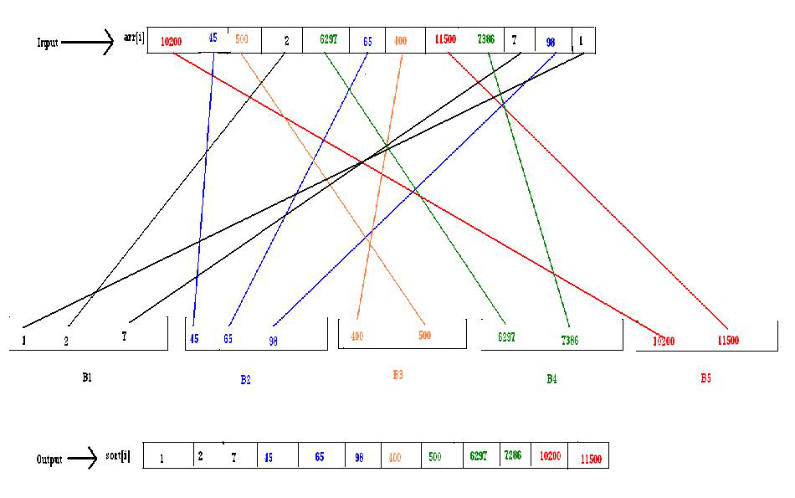

Slide 181
ALGORITHM
Step 1: Start
Step 2: Initialize pointer array of unsigned integer type variables to dynamically allocate memory i.e; arrin, arrout, b1, b2, b3, b4, b5 also initialize unsigned integer type variables i.e; count1, count2, count3, count4, count5, n, no, count, i, j, k=0.
Step 3: TAKE ‘n’ number of elements from user.
Step 4: TAKE ‘n’ number of input elements from user between 0 to 32767 range.
IF arrin[i] is greater than MAXD THEN,
! INPUT ELEMENT IS OUT OF RANGE.
EXIT
ELSE
TAKE input from user into arrin[i]
BEFORE SORTING ELEMENTS ARE:
for i=0, i less than ‘n’, increment i
PRINT arrin[i]
Step 5: TO COUNT NUMBER OF DIGITS
FOR( i=0, i less than ‘n’, increment i)
count=0.
no=arrin[i].
DO(no=no divided by 10
Count increment)
Check (no not equal to 0)

Slide 182
Step 6: GO TO CORRESPONDING DIGIT BUCKET
IF (COUNT=1)
PUT THE ELEMENT INTO b1
b1[count1]=arrin[i]
FOR(j=count1, j is greater than 0, j decrement)
IF(b1[j-1] is less than equal to b1[j])
BREAK.
ELSE
Temp=b1[j-1]
b1[j-1]=b1[j]
b1[j]=temp
Count1 increment
ELSE IF (COUNT=2)
PUT THE ELEMENT INTO b2
b2[count2]=arrin[i]
FOR(j=count2, j is greater than 0, j decrement)
IF(b2[j-1] is less than equal to b2[j])
BREAK.
ELSE
Temp=b2[j-1]
b2[j-1]=b2[j]
b2[j]=temp

Slide 183
Count2 increment
ELSE IF (COUNT=3)
PUT THE ELEMENT INTO b3
b3[count3]=arrin[i]
FOR(j=count3, j is greater than 0, j decrement)
IF(b3[j-1] is less than equal to b3[j])
BREAK.
ELSE
Temp=b3[j-1]
b3[j-1]=b3[j]
b3[j]=temp
Count3 increment
ELSE IF (COUNT=4)
PUT THE ELEMENT INTO b4
b4[count4]=arrin[i]
FOR(j=count4, j is greater than 0, j decrement)
IF(b4[j-1] is less than equal to b4[j])
BREAK.
ELSE
Temp=b4[j-1]
b4[j-1]=b4[j]
b4[j]=temp

Slide 184
Count4 increment
ELSE IF (COUNT=5)
PUT THE ELEMENT INTO b5
b5[count5]=arrin[i]
FOR(j=count5, j is greater than 0, j decrement)
IF(b5[j-1] is less than equal to b5[j])
BREAK.
ELSE
Temp=b5[j-1]
b5[j-1]=b5[j]
b5[j]=temp
Count5 increment
Step 7: TAKE ALL THE ELEMENTS OF EVERY BUCKET INTO ONE ARRAY.
FOR(j=0, j is less than count1, j increment)
arrout[k increment]=b1[j].
FOR(j=0, j is less than count2, j increment)
arrout[k increment]=b2[j].
FOR(j=0, j is less than count3, j increment)
arrout[k increment]=b3[j].
FOR(j=0, j is less than count4, j increment)
arrout[k increment]=b4[j].
FOR(j=0, j is less than count5, j increment)
arrout[k increment]=b5[j].
Step 8: AFTER SORTING ELEMENTS ARE:
FOR(i=0, i less than n, i increment)
PRINT arrout[i]
Step 9: STOP

Slide 185
COMPLEXITY ANALYSIS
Best Case : O(n2)
Worst Case : O(n2)
Average Case : O(n2)
ADVANTAGE
1. If the input elements are of different digits then the sorting algorithm is useful.
2. If the all input elements are of different digits then the comparison will decrease.
DISADVANTAGE
1. If all the input elements are of same digit then the complexity of the program will
increase and it is not applicable.

Slide 186
WHY WE NEED ASYMPTOTIC NOTATION TO MEASURE COMPLEXITY
* For given function g(n),we denote by o(g(n)) the set of functions that are different than g(n) by a constant Asymptotic upper bound.
* Here, we assume that we should compare the algorithm in an independent machine, i.e; if there is different types of processor, then their system may vary the execution time depending on the instruction format for execution each and every operations. If we consider two different machine for any algorithm to measure the complexity then we should prefer ASSYMTOTIC NOTATION.

Slide 187
HOW TO MEASURE COMPLEXITY ?
#include<conio.h>
#include<stdio.h>
void main()
{
int i,no;
printf("Enter number of lines :");
scanf("&d”,&no);
for(i=1;i<=no;i++)
{
printf("%d",i);
}
getch();
}

Slide 188
SNAP SHORT

Slide 189
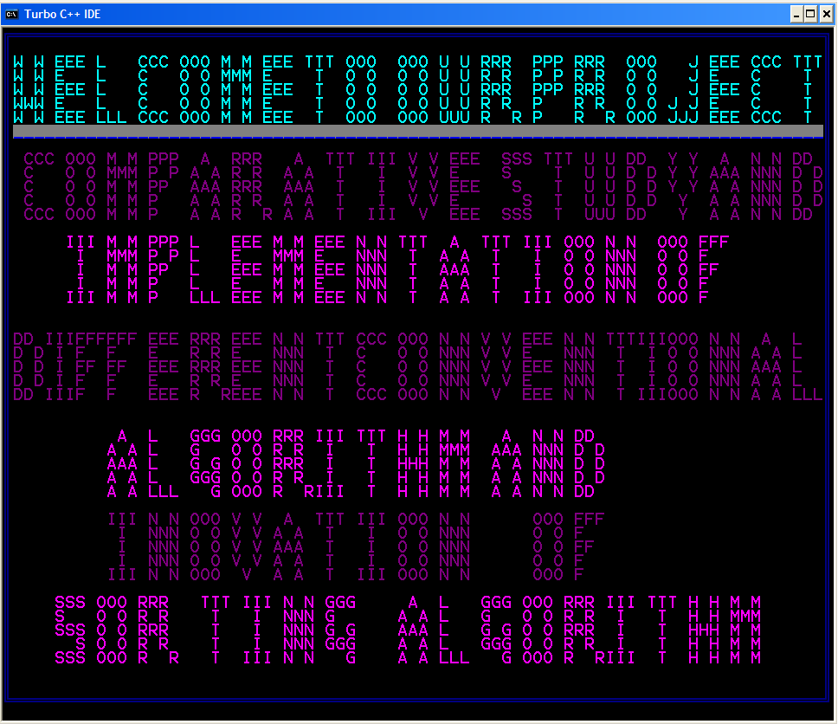
WHAT WE HAVE DONE ?

Slide 190
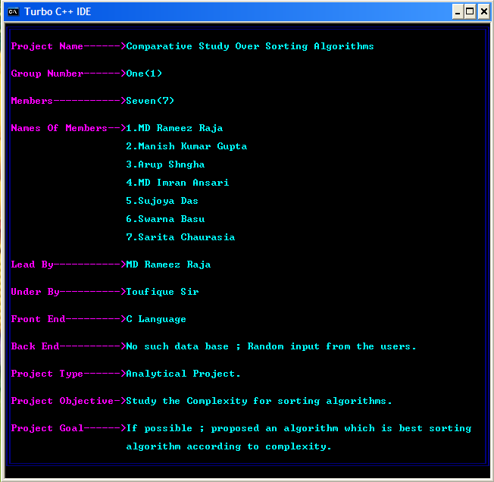
SCREEN SHOT OF MEMBERS NAME

Slide 191
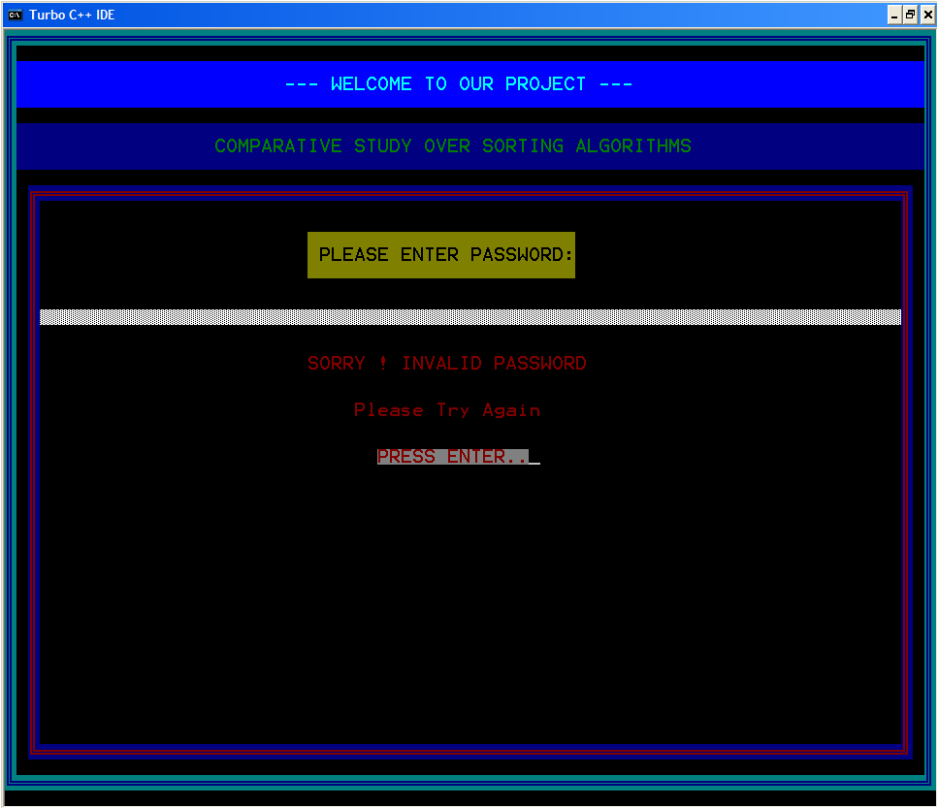
SCREEN SHOT OF THIS PROJECT LOGIN PAGE

Slide 192
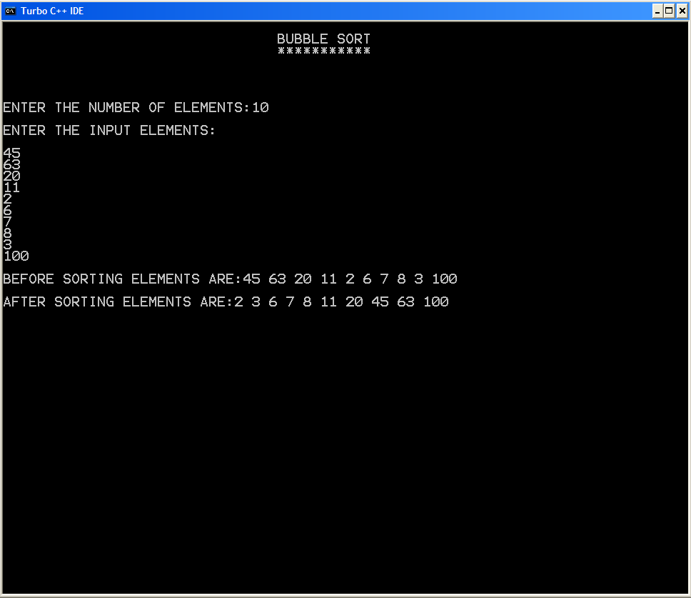
Bubble Sort

Slide 193
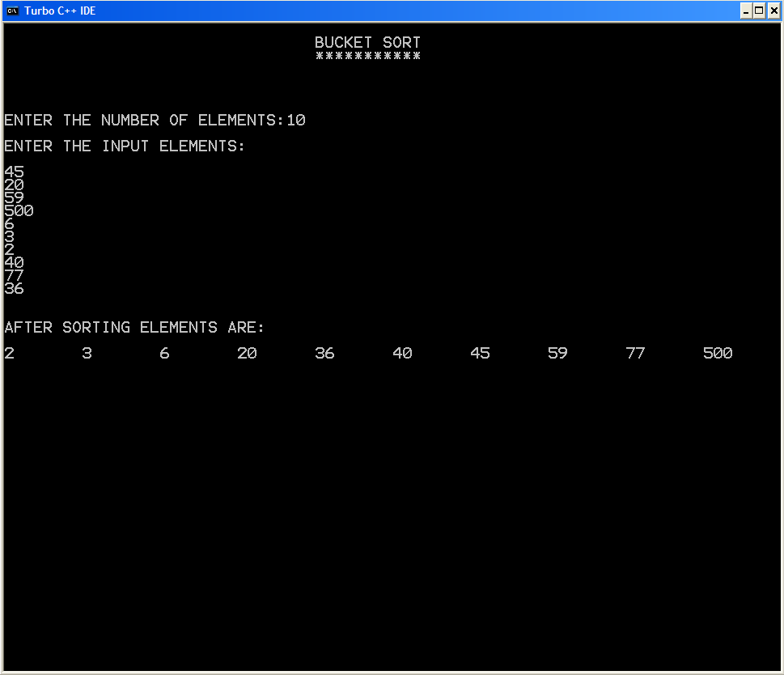
Bucket Sort

Slide 194
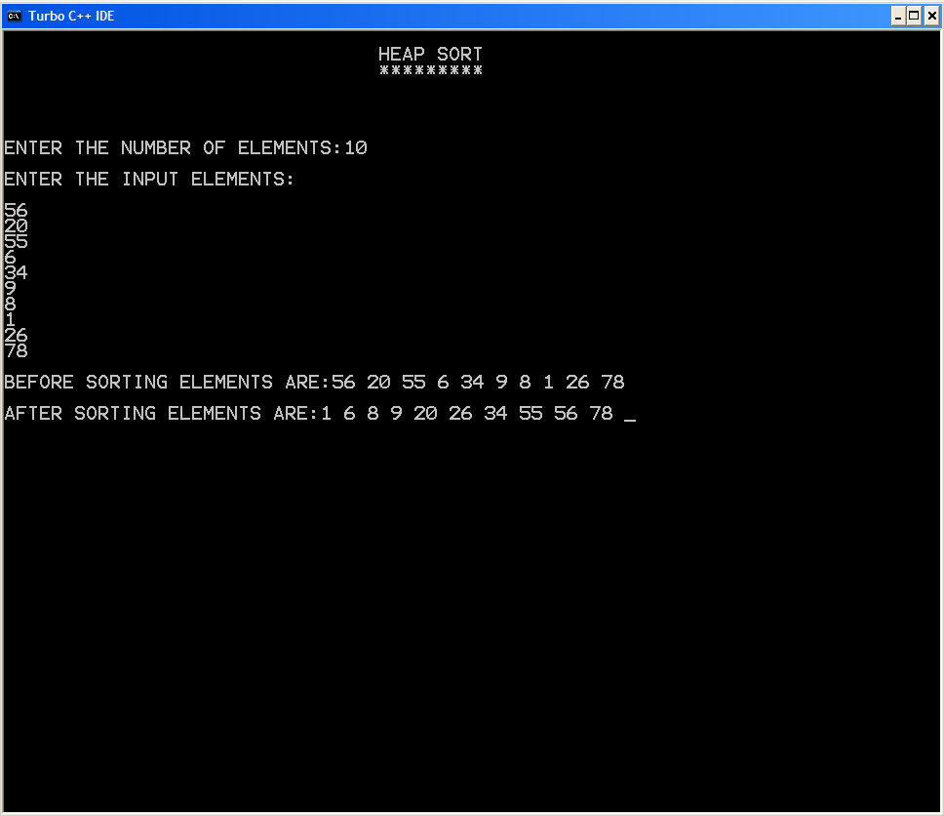
Heap Sort

Slide 195
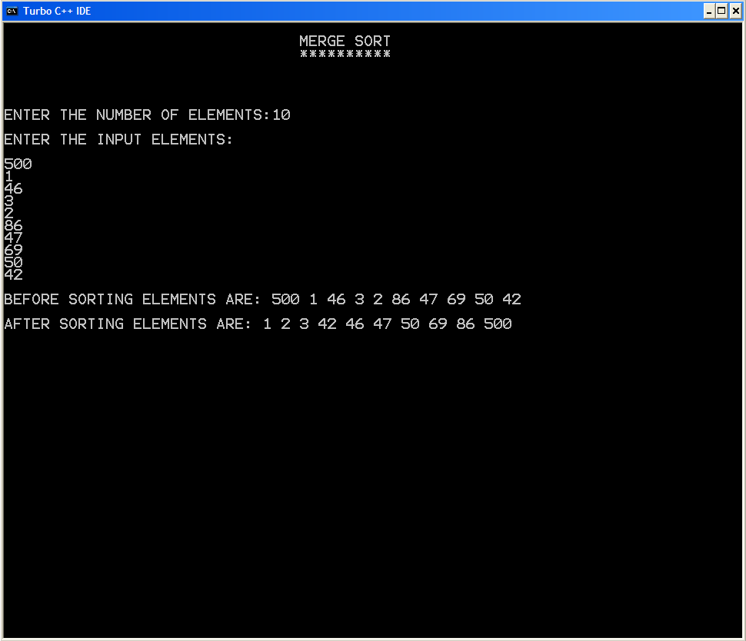
Merge Sort

Slide 196
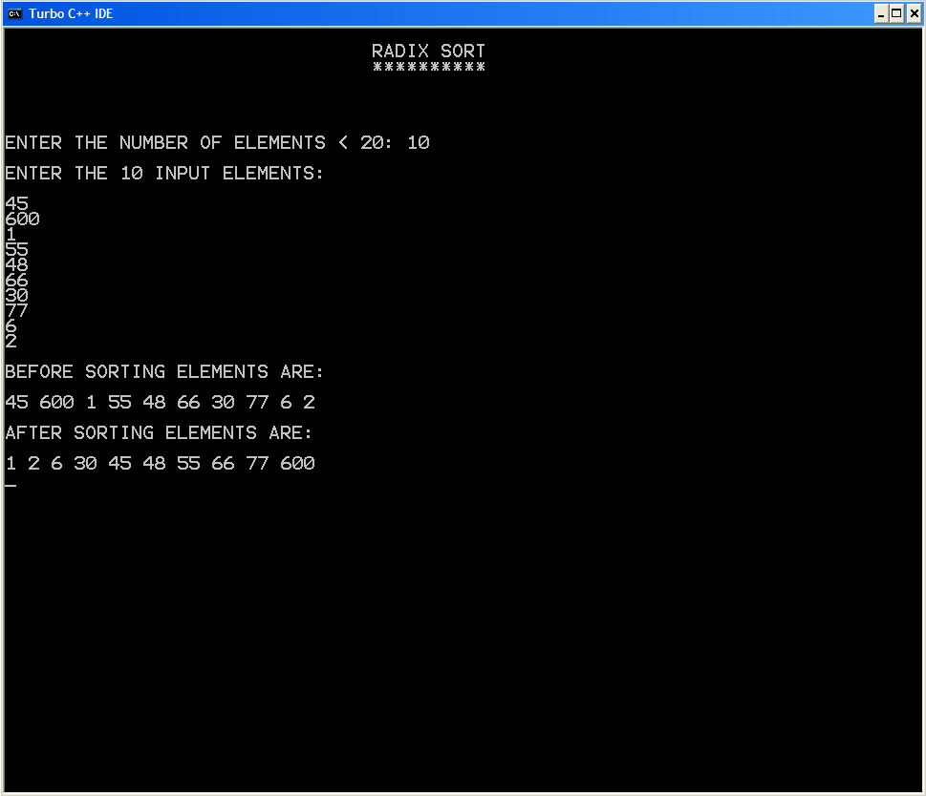
Radix Sort

Slide 197
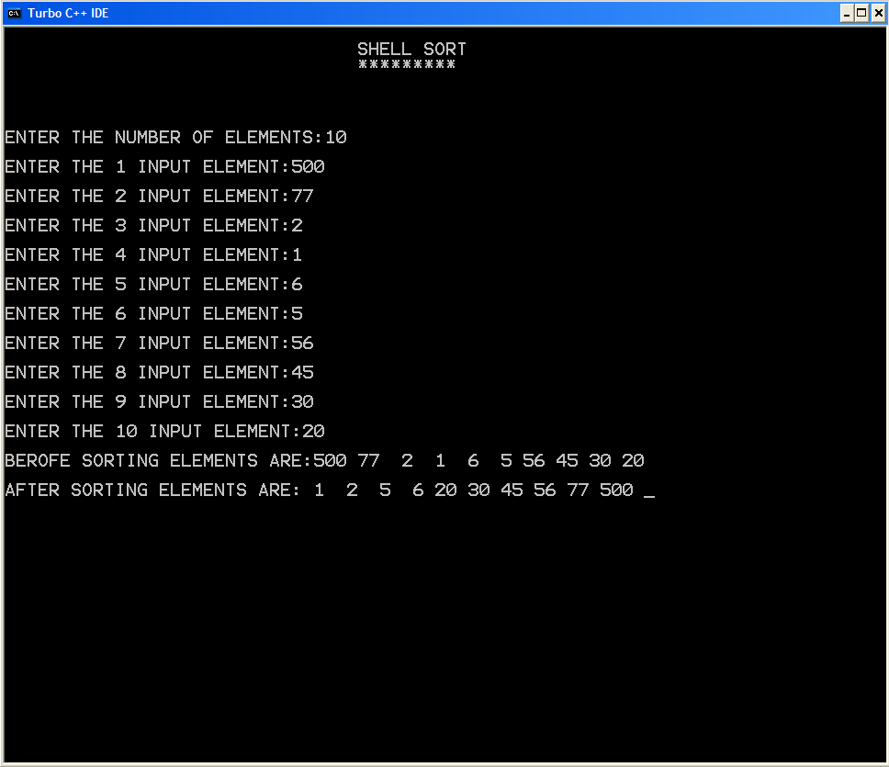
Shell Sort

Slide 198
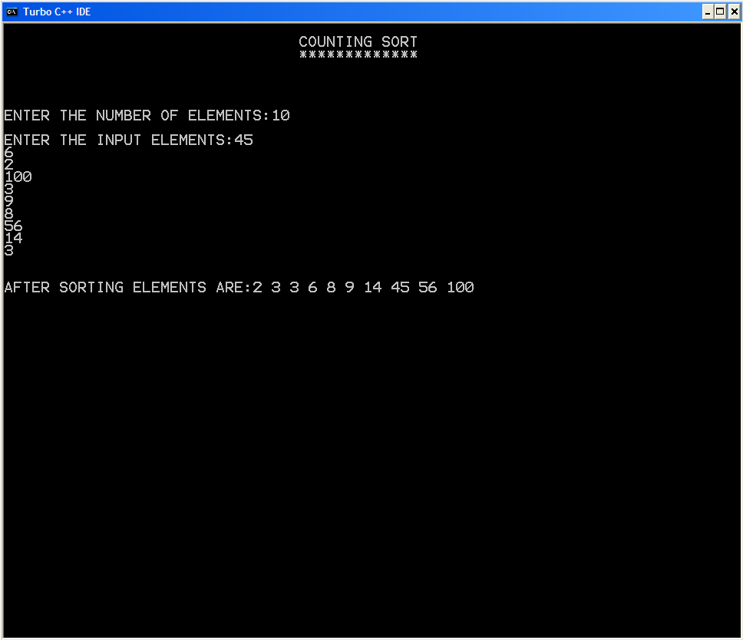
Counting Sort

Slide 199
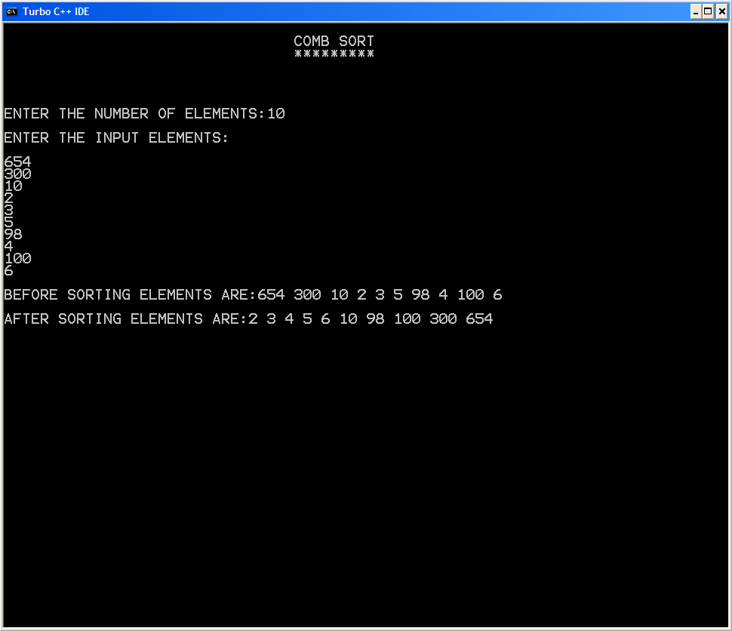
Comb Sort

Slide 200
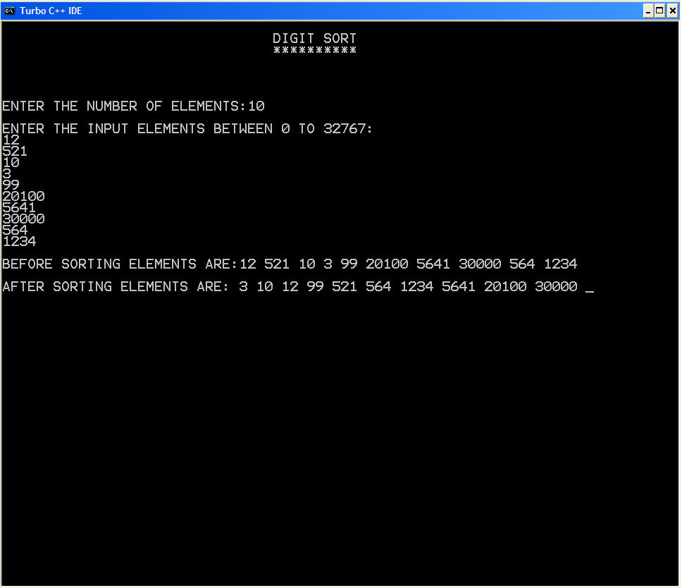
Digit Sort

Slide 201
CONCLUSION
By analyzing an algorithm, we mean to study the performance of an algorithm including the assertion of its correctness and a determination of the cost of its execution. Although a given algorithm is often analyzed in a particular way that is most suitable for such an algorithm, we are more interested in general procedures and techniques that can be used to study the performance of classes of algorithms. To be able to talk about general analysis techniques will not only add to our understanding of the behavior of a class of algorithms but will also, in many cases, lead to useful synthesis procedures. A good example illustrating these points is the various techniques that can be used to analyze a class of sorting algorithms which can be modelled as networks made up of comparator modules. In this paper, we discuss several approaches to such an analysis problem. Moreover, synthesis procedures suggested by these analysis techniques will also be presented.

Slide 202
THANK YOU

